Slide 1
PROJECT TITLE : SECURE DATA HIDING IN IMAGES USING STEGANOGRAPHY
CAPSTONE PROJECT
Presented By
Student Name : T.S.KUBERA VISHNU
College Name & Department : SRM UNIVERSITY & ECE

Slide 2
OUTLINE
Problem Statement
Technology used
Wow factor
End users
Result
Conclusion
Git-hub Link
Future scope

Slide 3
Problem Statement
This project focuses on secure data hiding in images using steganography to ensure covert communication. Existing methods face challenges in imperceptibility, security, and robustness against attacks. The goal is to develop an efficient system that embeds data while preserving image quality and resisting
steganalysis. Encryption and adaptive embedding techniques will enhance security and prevent unauthorized access. The proposed solution aims to enable reliable and secure hidden data transmission in digital images.

Slide 4
Technology used
Cryptography
Steganography Techniques
Image Processing Libraries
file explorer
idle python 3.11
python cv2
tikaher

Slide 5
Wow factors
Wow Factors of Secure Data Hiding Using Steganography
Invisible & Highly Secure Data Hiding – The hidden message remains completely undetectable to the
human eye, enhanced with encryption for double security.
Robustness Against Attacks – Advanced techniques (DCT/DWT) ensure resistance to compression, noise,and cropping, making the hidden data difficult to remove.
High Capacity with Quality Retention – Large amounts of data can be embedded without compromising image quality, ensuring seamless and efficient steganography.

Slide 6
End users
Government & Defense Agencies
Cybersecurity & Law Enforcement
Journalists & Whistleblowers
Corporations & Businesses
Medical & Healthcare Sector
Individuals & Privacy Advocates

Slide 7
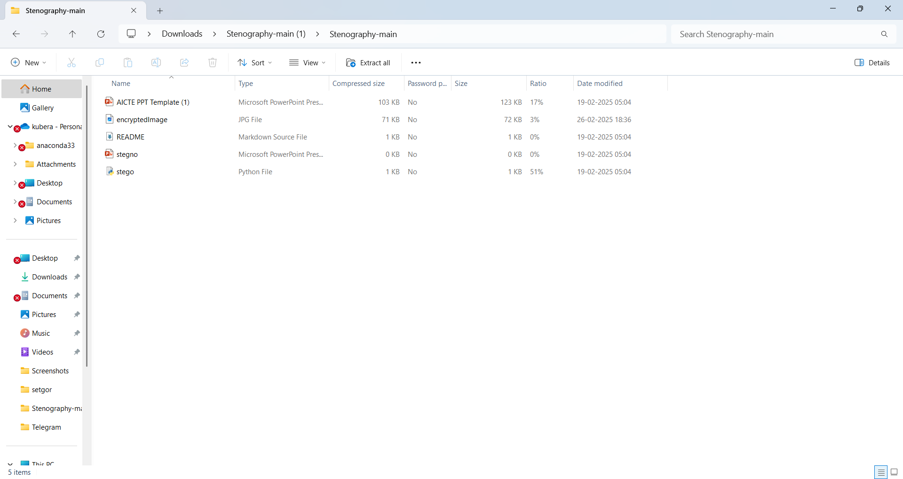
Results

Slide 8
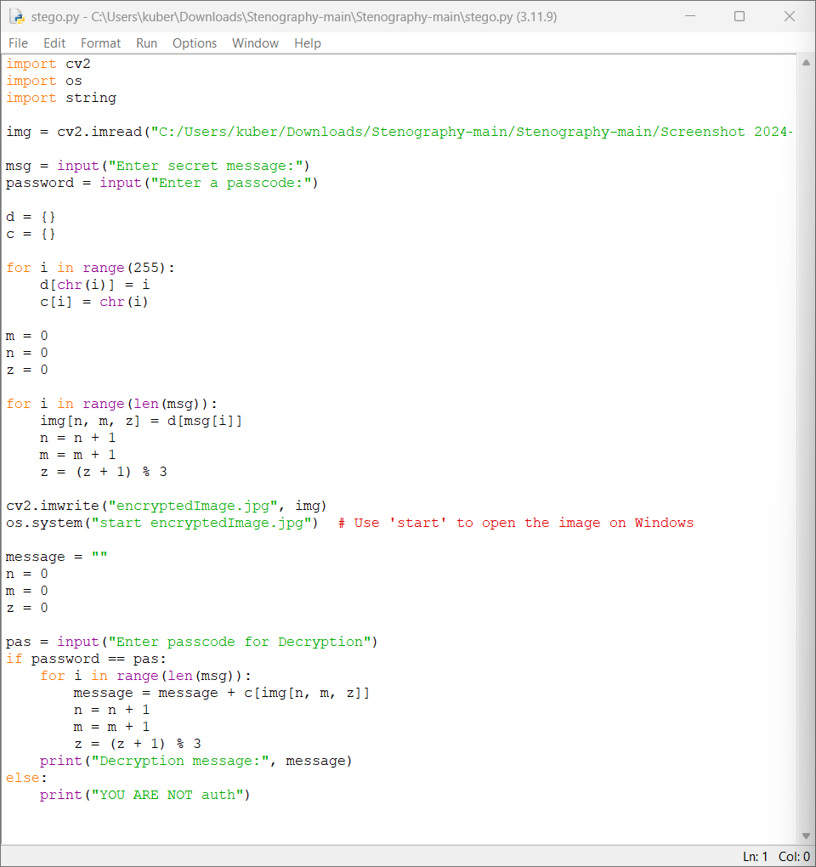
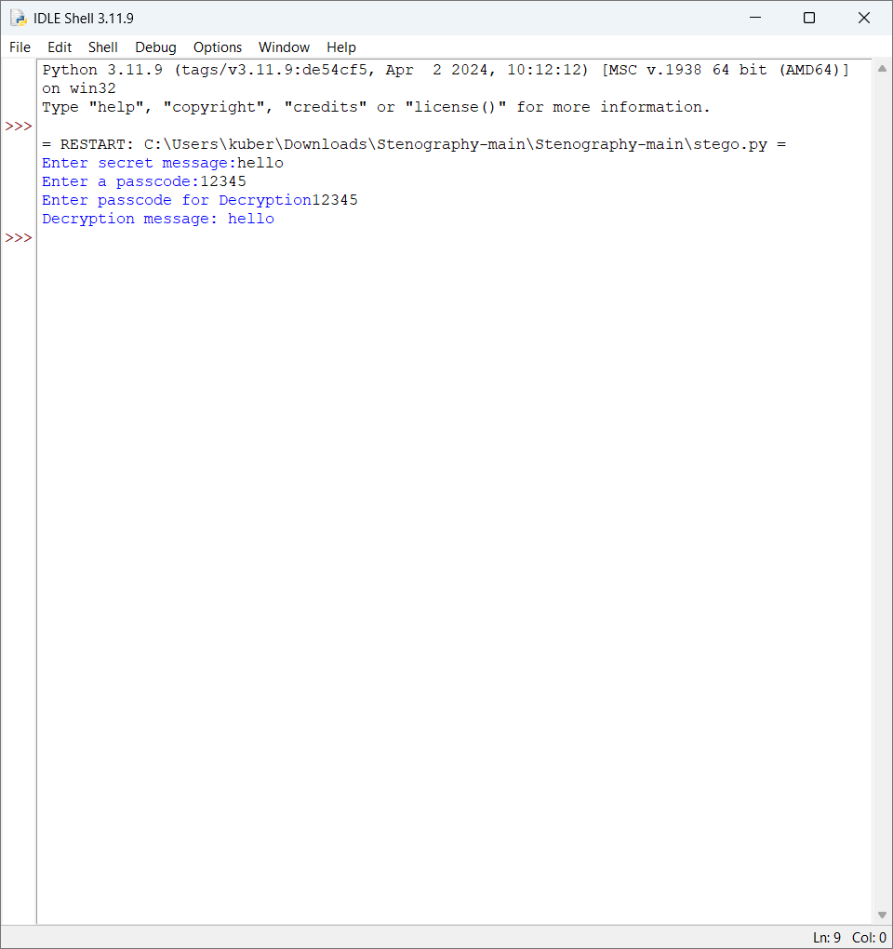

Slide 9
Conclusion
Steganography is a powerful technique for secure data hiding, ensuring confidential communication without raising suspicion.
By combining encryption and advanced embedding methods, it enhances security, robustness, and imperceptibility.
With evolving threats, future advancements in AI, quantum cryptography, and blockchain will further strengthen steganographic techniques.
This technology will continue to play a vital role in cybersecurity, digital forensics, and secure data transmission across various domains.

Slide 10
GitHub Link
https://github.com/tskuberavishnu/Secure-data-from-hackers.git

Slide 11
Future scope(optional)
The future of steganography lies in AI-driven techniques that enhance adaptive embedding and resist detection. Quantum-secure steganography will ensure protection against future quantum computing threats.
Blockchain integration can enable decentralized, tamper-proof hidden communication for enhanced security. Additionally, advancements in IoT and real-time video steganography will expand its applications in cybersecurity
and secure data transmission.

Slide 12
THANK YOU

